Slide 1


Research into Link Layer Discovery Protocols (LLDP): Types, Benefits, and Uses
This presentation explores Link Layer Discovery Protocol (LLDP) - a crucial networking protocol used for device discovery and network management.
by abdallah MOHAMMED

Slide 2
Introduction to LLDP
LLDP is a data link layer protocol that allows network devices to discover and exchange information about each other.
What it does
Where it operates
LLDP facilitates network mapping, device identification, and configuration management.
It works at Layer 2 of the OSI model, specifically in network switches and routers.

Slide 3
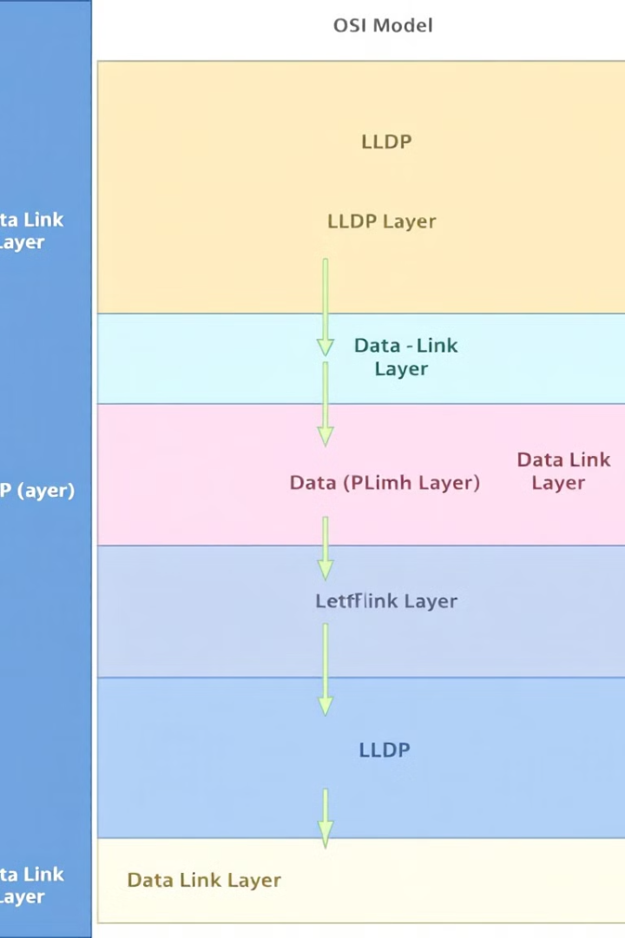
Understanding LLDP and Similar Protocols
LLDP is one of many discovery protocols, each with its strengths and weaknesses.
LLDP
CDP (Cisco Discovery Protocol)
Vendor-neutral and widely adopted for network management and troubleshooting.
Cisco-specific protocol, primarily used for discovering Cisco devices in Cisco networks.
FDP (Foundry Discovery Protocol)
Designed specifically for Foundry Networks equipment, not as widely used as LLDP.

Slide 4
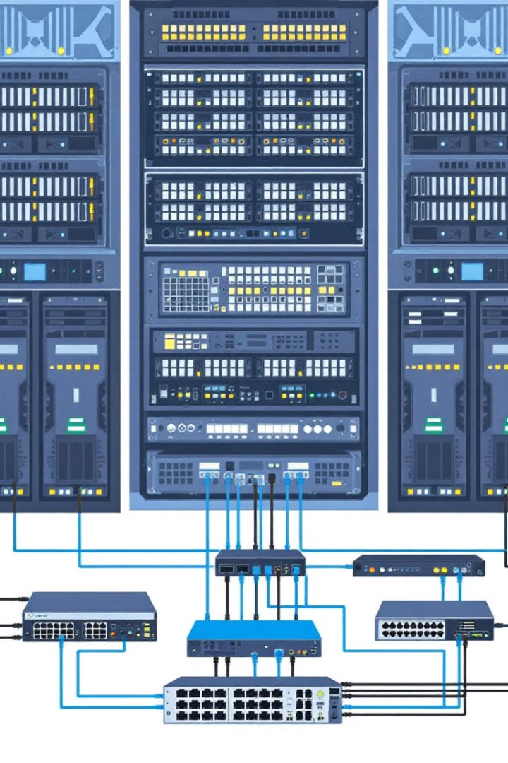



LLDP in Action: Devices and Environments
LLDP plays a critical role in various network devices and environments.
Switches
Discover neighboring devices, map topology, and monitor connections.
Routers
Exchange routing information with other network devices.
Servers and End Devices
Provide information about their connection for network management.

Slide 5

Comparing LLDP with Other Discovery Protocols
LLDP stands out compared to other discovery protocols due to its vendor neutrality and wide compatibility.
1
Vendor-Neutral
2
IPv6 Compatibility
Works with devices from different vendors, unlike CDP, FDP, and EDP.
While NDP is used in IPv6 networks, LLDP also supports IPv6, making it a valuable tool for modern networks.

Slide 6
Benefits of LLDP in Network Management
LLDP offers several benefits for network administrators, streamlining network management tasks and reducing downtime.
Efficient Network Mapping
1
Automates device discovery and creates dynamic network maps in real-time.
Device and Port Identification
2
Provides detailed information about devices, including port numbers, IP addresses, and device types.
Simplifies Troubleshooting
3
Helps quickly identify issues like misconfigurations, incorrect connections, or failures.

Slide 7
Case Studies: LLDP in Action
Real-world examples demonstrate LLDP’s impact on network efficiency and performance.
Large Enterprise Network Management
Data Center Optimization
Reduced manual network audits and improved troubleshooting times by 30% by implementing LLDP across the network.
Optimized bandwidth usage and reduced downtime by 25% using LLDP to monitor switch fabric and identify performance issues.

Slide 8


Practical Uses of LLDP in Networks
LLDP plays a crucial role in various network management tasks.
Topology Discovery
Creates a dynamic map of devices and their connections, providing real-time network visibility.
1
Network Monitoring Tools Integration
2
Provides live network status, device details, and performance metrics through integration with monitoring tools.

Slide 9
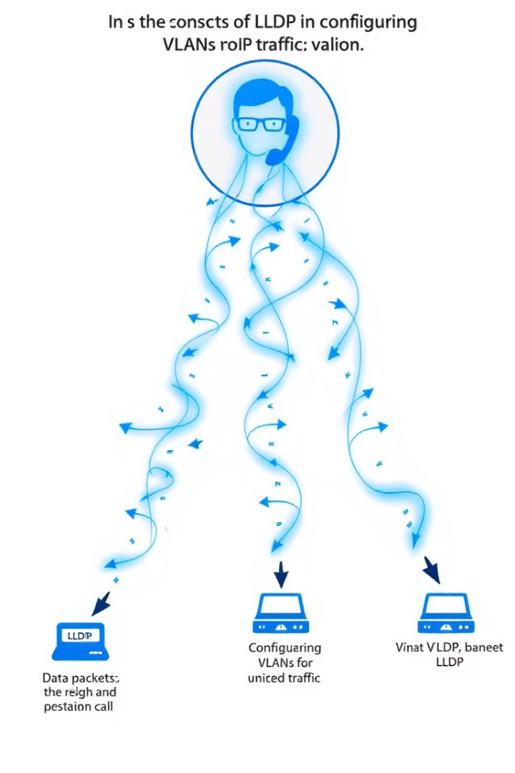



LLDP in VoIP Deployments
LLDP is essential for ensuring seamless and high-quality VoIP operations.
Automatic VLAN Configuration
Identifies VoIP devices and configures them to use the correct VLANs for voice traffic, ensuring call clarity.
QoS (Quality of Service)
Enables QoS on devices, prioritizing voice packets over other network traffic for reliable call quality.
Simplified Network Setup
Automates VoIP device connection settings, reducing setup time and minimizing human error.

Slide 10

Key Takeaways and Next Steps
LLDP is a vital tool for network management, offering numerous benefits for streamlining operations, improving troubleshooting, and optimizing network performance.
1
Implement LLDP
Ensure LLDP is enabled on all network devices to maximize its benefits.
2
Integrate Tools
Utilize network monitoring tools that integrate with LLDP for real-time network insights.
3
Stay Informed
Keep up with updates and advancements in LLDP and its applications.

